Slide 1
A Mobile Decision Support System for Tourist Planning
Haakon Borch
Master Thesis
University of Bergen

Slide 3
Goals
Produce a Decision Support Systems (DSS)
On Mobile
For tourists
To solve the problem:
“What can I do today while at this location?
Notes:
Hold det fokusert på det akademiske og kutt ned på at I and i AND I DID
Ekstra slide i forhold til forklaring til singel og gruppe personal enterprise

Slide 4
Decision Support Systems
Intended to aid humans in making decisions as opposed to AI
Personal vs enterprise
Intelligent - uses AI techniques to generate suggestions
Mobile DSS (MDSS)
Availability of location-data
Lack of research

Slide 5
Research Question
Research Question 1: Can an intelligent MDSS using location-dependent information for aiding tourists be built?

Slide 6
Research Method
March and Smith (1995)
Build an instantiation
Prototyping (Davis, 1992)
Throwaway
Evolutionary
Notes:
Add navn på paperen til march and smith
Hovedforskjellen på throwaway og evolutionary, at du kaster vekk og beholder evolutionary

Slide 7
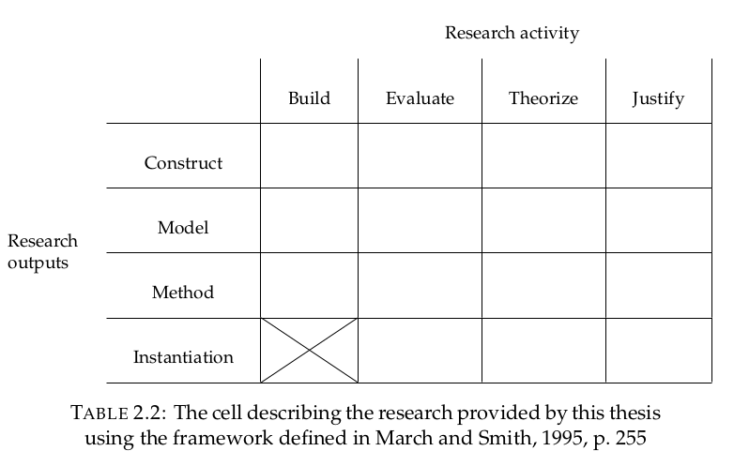
March and Smith
Notes:
Hold forklaringen kort her

Slide 8
Specifications
All calculations done on device
On Android using Java
Using survey data from Innovation Norway
Using location data from Google Maps
A day is defined as consisting of five activities
Notes:
Kanskje litt forvirrende plassering med background
Husk å sleg på kva forkårtalsene betøyr -Karsten

Slide 9

Bayes theorem and Naive Bayes
Bayes theorem - updating beliefs based on evidence
Naive Bayes - assuming conditional independence between variables
Conditional independence - knowledge of probability distribution of A does not provide knowledge of same for B given some third event C
Vocabulary and height are not independent, but given age they are conditionally independent
Notes:
Gi eksempel på hvordan det blir brukt re sosiologiske verdier.
Fiks teorem til hvit
Mer konkrete eksempler på bruk re alder, høyde vokabular heller enn formler.
Bra plass for visualisering conditional dependence and independence

Slide 10
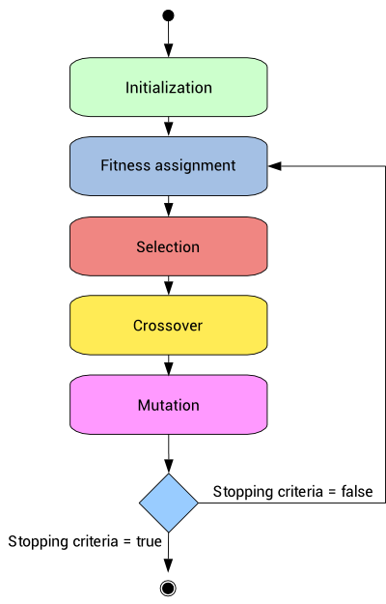
Genetic Algorithms
Population of Individuals
Each generation:
Ranked according to Fitness function
Used to generate new Population by:
Crossover
Mutation
Until Fitness criteria or time
Notes:
Spesifiser konkret use. At den blir brukt til å generere suggestions på dag.
For understandability.
Dropp crossover og mutation

Slide 11
How does the artifact work?
User answers Questionnaire
Answers used to generate probabilities of interest
First round of GA - find Google Maps categories of interest
Information gathered from Google Maps
Second round of GA - find specific locations and a path between these
Suggestion presented to user
User accepts or rejects

Slide 12
Constraints
For each GA there were constraints that modified the fitness-function
Reward for food as 3rd
Reward for food as any
Penalty for “non-interesting”
Penalty for repeat categories
Penalty for laybacks / inefficient paths

Slide 13
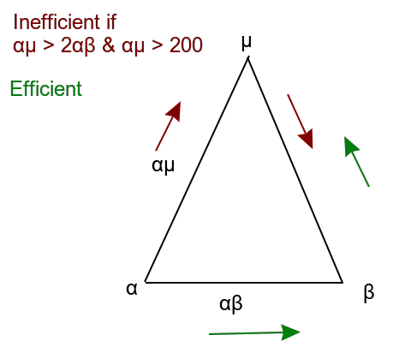
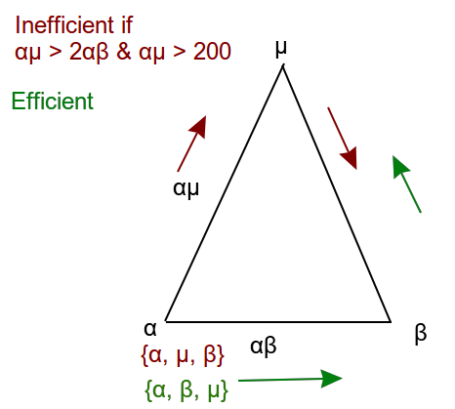
Inefficient Path
Given a path between three points {α, μ, β},
an inefficient path is one where the distance between
the points is such that the distance-inequality
αμ > 2αβ holds and the distance of αμ > 200m.
Intended to avoid going out and back again
Notes:
Visualisering med ikke-sort bakgrunn
Ikoner av bygniniger heller enn symboler
Endre theta til annen variabel
Pil for å vise ordering

Slide 14

Finding the distance between two points on a sphere
Definition: Inefficient Paths
Haversine Formula
Given point p 1 at latitude φ 1 and longitude λ 1 and point p 2 at latitude φ 2 and
longitude λ 2 the haversine formula for the distance(d) between p 1 and p 2 is
Notes:
Flytt kanskje teorien til en egen seksjon

Slide 15
Termination Condition
Time-based
Described by:
2ω + θ
ω is the maximal running time of a GA round, 5 seconds
θ is the timeout value of the connection-request to Google Maps API
Notes:
Endre theta til annen varibel

Slide 16









Tools
Statistical Package for Social Sciences statistics (SPSS statistics)
R and Rstudio
Java and Android
Watchmaker
Dev tools:
Git, CircleCI, Slack, RxJava and StarUML
Notes:
Flytte denne til etter specification?
Bør kanskje inlede til utviklingen av prototypen
eller kanskje kutte ut (karsten)

Slide 17
Preparing the data from Innovation Norway
164 variables in survey
Reduced to 17, 11 activities and six sociological variables
Purpose of the trip
Permanent residence
Age
Gender
Education Level
Employment status
Mapped the 90 available Google Map categories to 11 bins of activities

Slide 18
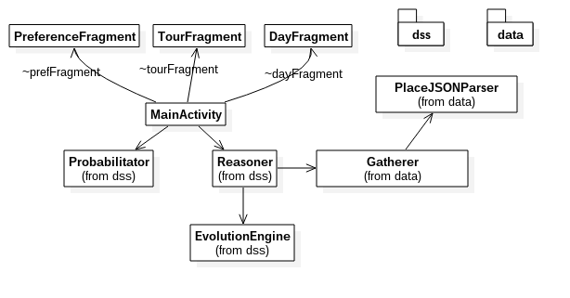
Overview
Notes:
Title overall system
Vær eksplisitt på hvor magien skjer og pek på hvordan magien henger sammen over å forklare resten.

Slide 19
Probabilitator
For each of the 11 activity types:
Generating priors of interest from data
Generating conditional probability of interest from Sociological values of user
Multiplying probabilities with assumption of conditional independence
Naive Bayes
Normalizing probabilities for each activity

Slide 20
Watchmaker
Implemented in EvolutionEngine class
For each round of GA, Activity and Day:
Factories - Produced initial population
Problems - Contained constraints
Evaluators - Provided fitness-function

Slide 21
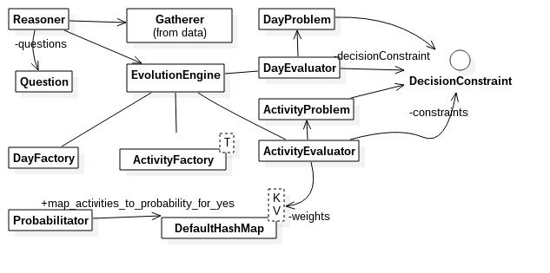
Evolution Engine
Notes:
Tittel evolution engine
Activity here is not android activity
Streken !!!

Slide 22
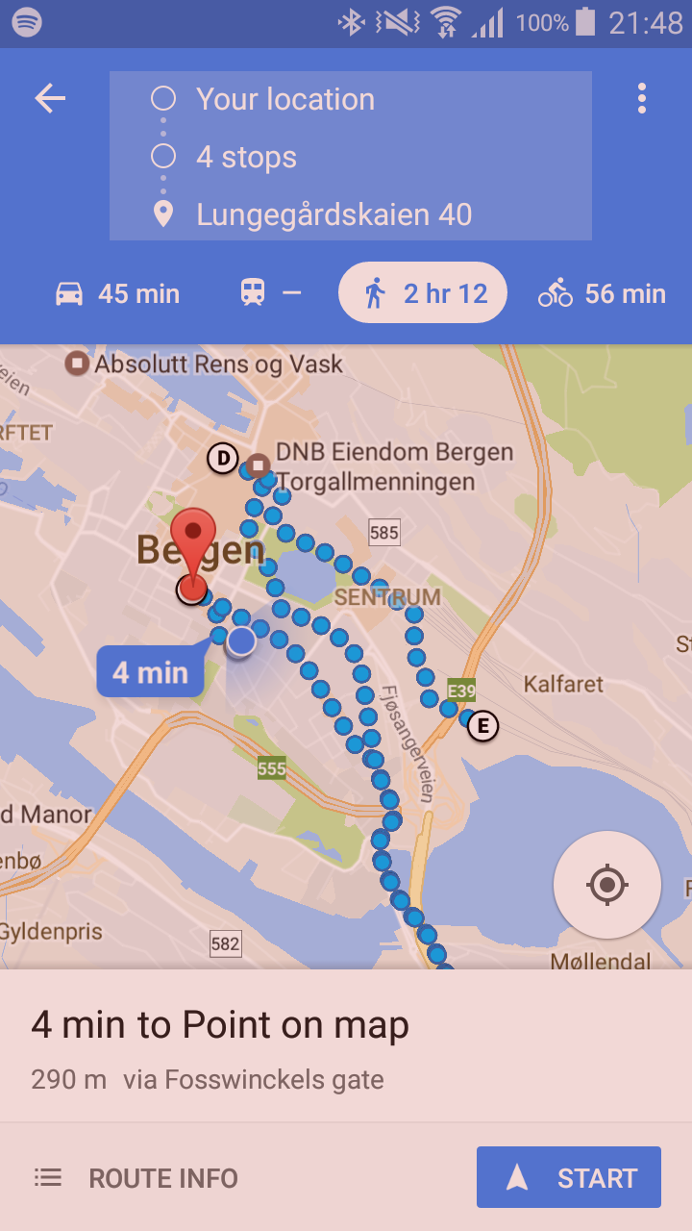
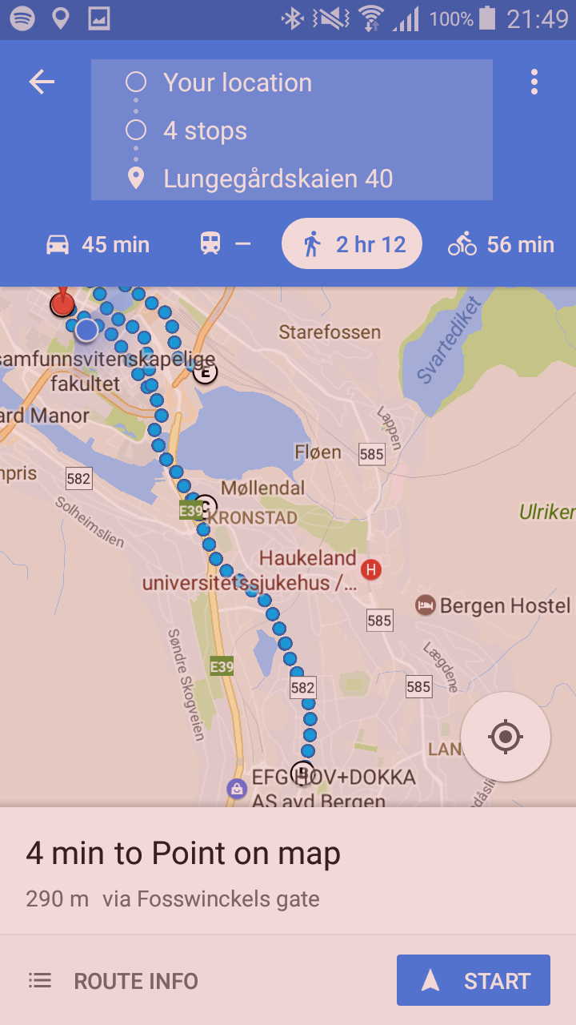
Notes:
Finne bedre bilder? Genere nytt

Slide 23
Evaluation
Purpose
Answering the research question
Method
User-test
Ideal user-test
Notes:
Skriv med om de brukerene som ble testet og den genererte ideal user

Slide 24
User-Test
Three users
Expert domain-knowledge in IT, availability and mobile application development
Task-completion
Provided feedback
Two: positive
One: needs work - got recommended to visit a funeral home
Feedback used for improvements - additional penalty and reward constraints

Slide 25
Defining an Ideal User
• Aged between 30-60
• From Norway
• Other vacation activities
• Employed
• Not a student or Researcher
Each of these values has 50% coverage in the data

Slide 26
Ideal User-Test
26 suggestions generated using definition of Ideal User
Each suggestion rated on amount of “interesting” activities
Interesting defined as estimated to be relevant to tourist visiting Norway
Results:
76% of suggestions contain at least one “interesting” activity

Slide 27
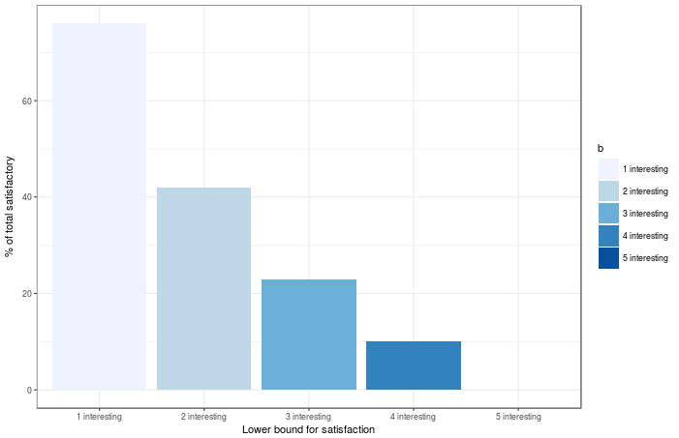
Notes:
Teksten må være mehr les bar om mulig
Kanskje skrive prosentene over stolpene
The amount of interesting activities as percentages over all of the 26 generated suggestions

Slide 28

A “non-interesting” suggestion
Location 1: Jula (Hardware Store)
Location 2: Bergen Police station- lost and found
Location 3: Vinmonopolet (liquor store)
Location 4: Helsetorget (doctors office)
Location 5: Vinmonopolet (a different liquor store)
Notes:
Skriv bulletpoints på disse forslagene

Slide 29
Research Question
Research Question 1: Can an intelligent MDSS using location-dependent information for aiding tourists be built?

Slide 30
Answering the Research Question
Properties of artifact needed for affirmative answer:
Is an intelligent MDSS
Uses location-dependent information
Intends to aid Tourists
It works
Assuming lowest floor for “it works”, the RQ can be answered affirmatively
Notes:
Ha en slide som viser research questionet
“It” works og ikke bare works

Slide 31
Validity
Research Question and Background
Group-data for predicting individuals
Bias from mapping 11 activity types to Google Maps categories
Arbitrary constraints
Tuning the settings of the GA
Notes:
Rework til å vise frem alternative måter å gjøre på og ressonering til hvorfor spesifik måte

Slide 32
Alternatives
Bayes & GA vs only GA
On-device vs Server
Performance
Threading
Target platform of library
Garbage-collection and real time termination

Slide 33
Evaluation
Overlap between real testers
Evaluation without testing
Users only tested one suggestion
Arbitrariness of ideal user

Slide 34
Future Work
Taking into account memory-limitations
Developing with the computation being done on server
Using a tuning-aware methodology for GA for improved quality
Exploring tourist preference prediction and modelling
A / B testing with random suggestions for evaluation

Slide 35
Thank you

